Slide 1



Large Language Models ( LLMs)

Slide 2
Big Picture :
What is a natural language?
What does a language model do ?NLP tasks
Gen AI
Evolution of NLP to LLM
LLM models
Challenges of LLM issues
Use cases of LLM
LLM based Companies- Opportunities

Slide 3
Key components of a natural Language
Citation Note:

Slide 4
Key components of a Languge
Syntax: Syntax refers to the arrangement of words and phrases to create well-formed sentences in a language.
Semantics: Semantics pertains to the meaning of words, phrases, and sentences in a language
Phonology: Phonology deals with the sound system of a language, including the organization and patterns of speech sounds.
Morphology: Morphology focuses on the structure and formation of words in a language
Grammar: Grammar encompasses the rules and principles governing the structure and usage of language

Slide 5
What does a language model do
Citation Note:

Slide 6
Language model : tasks
Sentiment Analysis:Named Entity Recognition: Identify and classify entities in text.
1
Part-of-speech Tagging: Assign part-of-speech tags to words in sentences.
2
Dependency Parsing: Determine syntactic structure and relationships between words.
3
Machine Translation: Translate text between languages while preserving meaning.
4
Text Summarization: Generate concise summaries of text while retaining main ideas.
5
Question Answering: Provide accurate answers to questions based on context.
6
Natural Language Inference: Determine relationships between sentence pairs.
7
Coreference Resolution: Identify when words in text refer to the same entity.
8
Paraphrase Detection: Determine if two sentences express the same meaning.
9
Language Models aims to model the generative likelihood of word sequences, so as to predict the probabilities of next word

Slide 7
Speech Recognition: Language models assist in converting spoken language into text by predicting the sequence of words or phonemes that most likely correspond to the input speech.
Text Generation: Language models can generate human-like text, which finds applications in chatbots, virtual assistants, content generation, and creative writing.
Information Retrieval: Language models assist in retrieving relevant information from large text corpora or databases by analyzing the context of queries and matching them with relevant documents.
Spell Checking and Auto-correction: Language models help in detecting and correcting spelling errors by suggesting the most probable correct words based on the context of the input text.
Search Engine Optimization (SEO): Language models play a crucial role in understanding search queries and ranking web pages based on their relevance to the user's intent, thus improving search engine performance.
Language Understanding and Dialogue Systems: Language models aid in understanding natural language queries and generating appropriate responses in dialogue systems, including chatbots, virtual agents, and customer service applications.
Language Modeling Research: Language models serve as a fundamental tool for researchers in linguistics, cognitive science, and artificial intelligence to study and understand various aspects of human language, such as syntax, semantics, and pragmatics

Slide 8
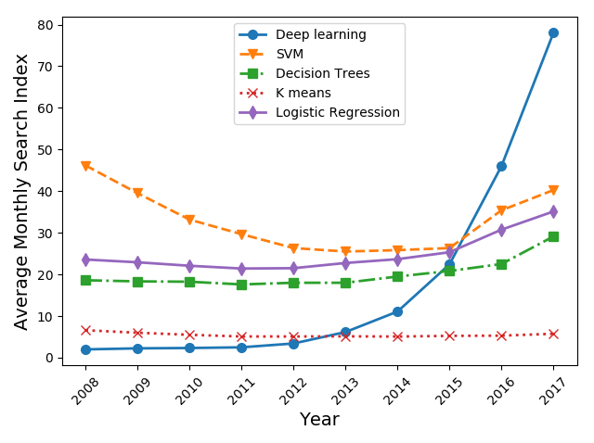
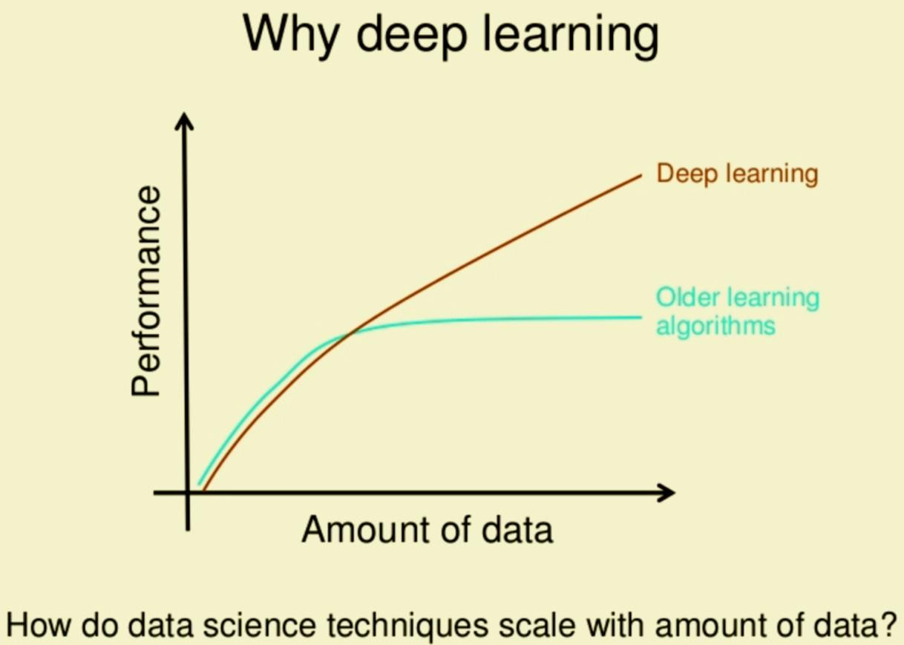
LLMs are Deep Learning Models
Promising results if trained with lot of data!
Artificial Intelligence Paradigmshift!-
Machine Learning and Deep Learning?

Slide 9


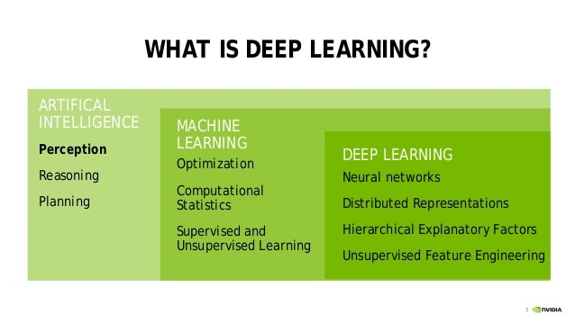

Slide 10
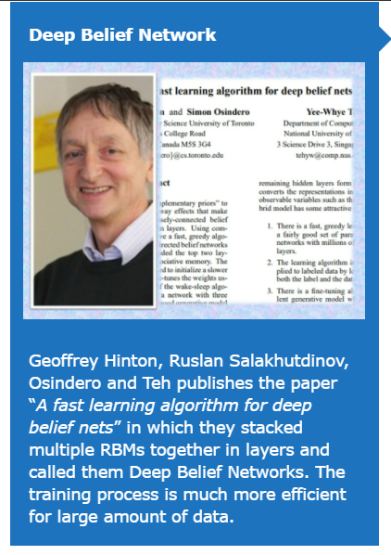
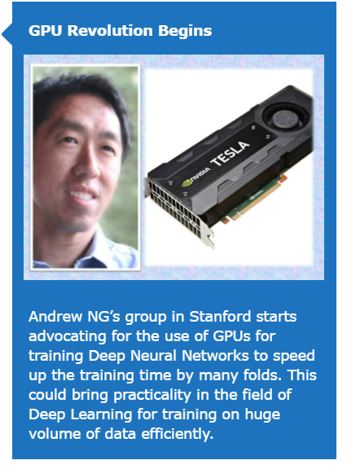
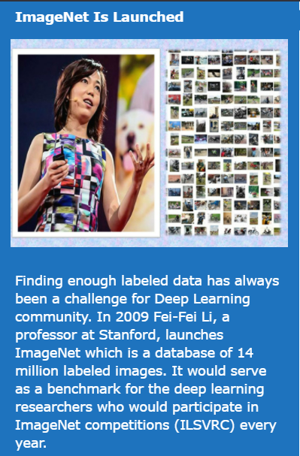
2006
2008
2010
Courtesy: machinelearningknowledge.ai

Slide 11
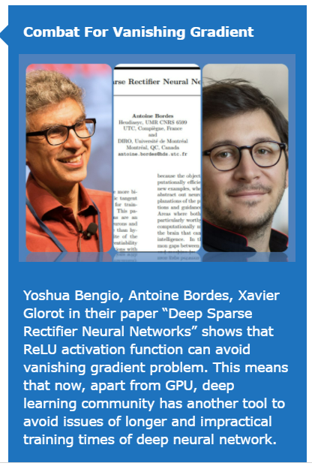
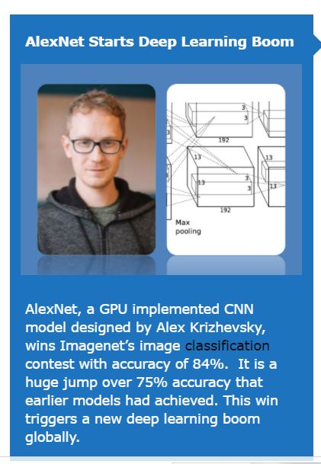
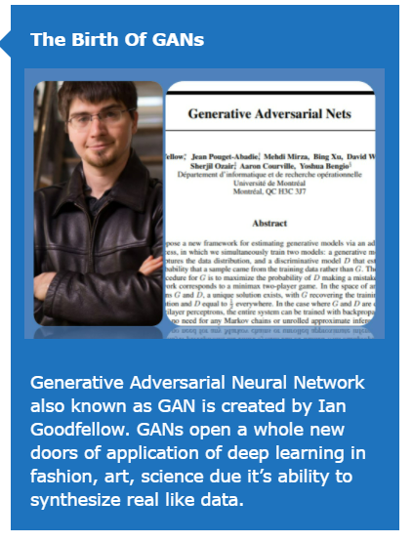
2012
2014
2011

Slide 12
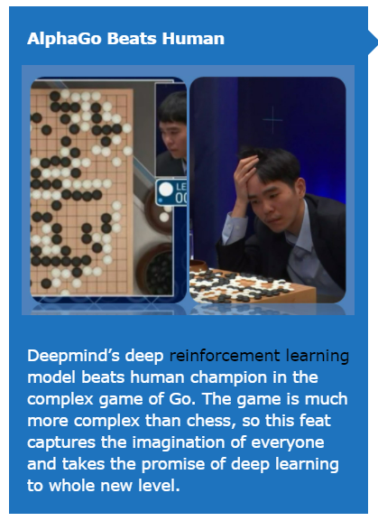
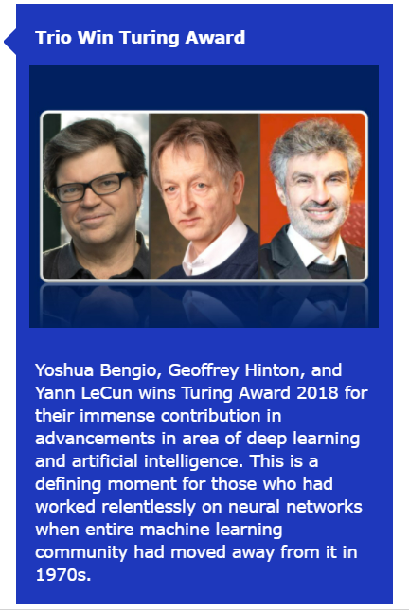
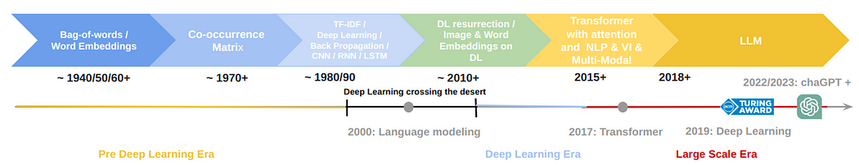
Geoffrey Hinton
long known as the "Godfather of Deep Learning“
was a Google researcher
2016
2019
Courtesy: machinelearningknowledge.ai

Slide 13
2017 - Deep learning architecture referred to as transformer was proposed; [Vaswani]- Attention is all you need
2018 - Groundbreaking Generative pre-trained transformers (GPT), a type of large language model, was introduced by OpenAI;
2021 - AI platform DALL-E intended for generating and editing unique artworks and photorealistic images was launched;
2022 - Open source Stable Diffusion and proprietary Midjourney AI image-generating tools were introduced;
2023 - GPT-4 was released in March 2023, capable of generating longer texts up to 25000 words.
Generative AI
Large Language Models
ChatGPT is based on GPT-4, a massive language model with 175 billion parameters, trained on Large Corpus of webtexts, books , news Articles, social media posts

Slide 14




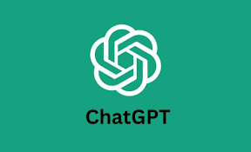

Generative AI
DeepFake
https://thispersondoesnotexist.com/
Output from DALLIE : OPEN AI
An astronaut riding a horse in photorealistic style.
DALL·E 2 can create original, realistic images and art from a text description. It can combine concepts, attribute

Slide 15
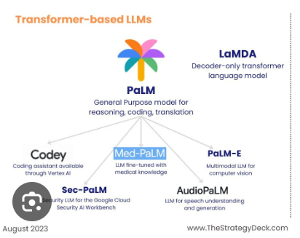
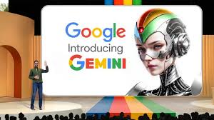
Google’s
lightweight version of LaMDA
Google LaMDA (Language Model for Dialogue Applications)
PaLM is designed to be used for large-scale language generation tasks, such as machine translation or content generation.

Slide 16


Midjourney wonders
A dreamy castle inside an enchanted forest
Prompt: A scene in the space where the crew of the spaceship, the Star Explorer, had been warned about the treacherous asteroid field but were determined to traverse it to reach their destination. As they flew through the field, they were suddenly ambushed by an alien armada of ships, intent on capturing the Star Explorer, surreal digital art, otherworldly, dreamlike, abstract, hyper-detailed, art deco

Slide 17


Create a Fully Illustrated Story with ChatGPT and Midjourney
Step 1 – Create a prompt for the story
“Create a fantasy adventure story based on the following information: two main characters, main plot, and location in Amazon Jungle.”
Step 2 – Run the prompt in ChatGPT
Step 3 – Create a prompt for the character background stories
Step 4 – Run a Python GPT-3 Script
Step 5 – Narrator Voice Over
Step 6 – Improve Narrator Voice
Step 7 – Create Images in Midjourney
Step 8 – Put It All Together
Jake Stormbringer, a handsome 35 years old expedition researcher, from California, USA, MIT graduate
Eve Thompson, a 22 year old stunning beautiful afro american expedition researcher, from London , UK, Oxford Graduate

Slide 18
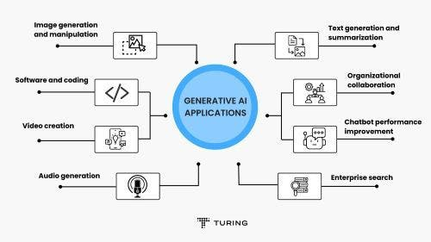
Generative AI

Slide 19

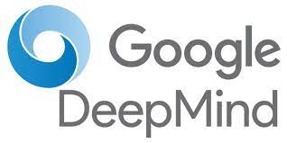
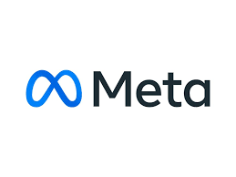
Major Players………..
Google Brain (Googel AI): Jeff Dean and Geoffrey Hinton
Geoffrey Hinton - referred to as the "Godfathers of AI" and "Godfathers of Deep Learning"; Turing Award(2018) with Yoshua Bengio and Yann LeCun; Known for Backpropagation, Boltzmann machine, deep learning, and Capsule neural network; Notable students: Yann LeCun, IIya Sutskever, Ruslan Salakhudinov
Many well-known models are from Google, such as Transformer, BERT, LaMDA/LaMDA 2, and PaLM, a 540 billion parameters model in Google I/O22.
Bard is a conversational generative artificial intelligence chatbot developed by Google. Initially based on the LaMDA family of large language models (LLMs), it was later upgraded to PaLM and then to Gemini.
DeepMind is a subsidiary of Alphabet Inc, the parent company of Google.:Demis Hassabis(CEO), David Silver (Lead Research), Ian Goodfellow: Known for Generative adversarial networks (GAN). Student of Yoshua Bengio
AlphaFold, AlphaGo / Alpha Go Zero / AlphaZero / MuZero Go, AlphaStar
Meta AI (Facebook AI Research)
Yann LeCun - Known for Deep learning; Turing Award (2018) . Student of Geoffrey Hinton
PyTorch - an open-source machine learning framework based on the Torch library, used for computer vision and natural language processing, primarily developed by Meta AI.

Slide 20



OPEN AI
Its AI talent team is led by Ilya Sutskever, Chief Scientist of OpenAI, the co-inventor AlexNet, and John Schulman.
The GPT-3, released by OpenAI in 2020, is one of its star products
Another product released by OpenAI, DALL·E 2, also went viral. It can create realistic images and art from a description in natural language.
trained a model called ChatGPT which interacts in a conversational way.
it can write and debug computer programs,compose music, teleplays, fairy tales, and student essays; answer test questions (sometimes, depending on the test, at a level above the average human test-taker);write poetry and song lyrics; emulate a Linux system; simulate an entire chat room; play games like tic-tac-toe;
MidJourney : hosted by San Francisco–based independent research lab Midjourney, Inc. Machine Creates Art works
Microsoft Research- 1990
Apple
Tesla
IBM
Nvidia
Hugging Face has become well-known in the AI community for its free, open-source transformers library, which is used by thousands of programmers all around the world to build cutting-edge AI models for a range of tasks, including sentiment analysis, language translation, and text summarization.

Slide 21
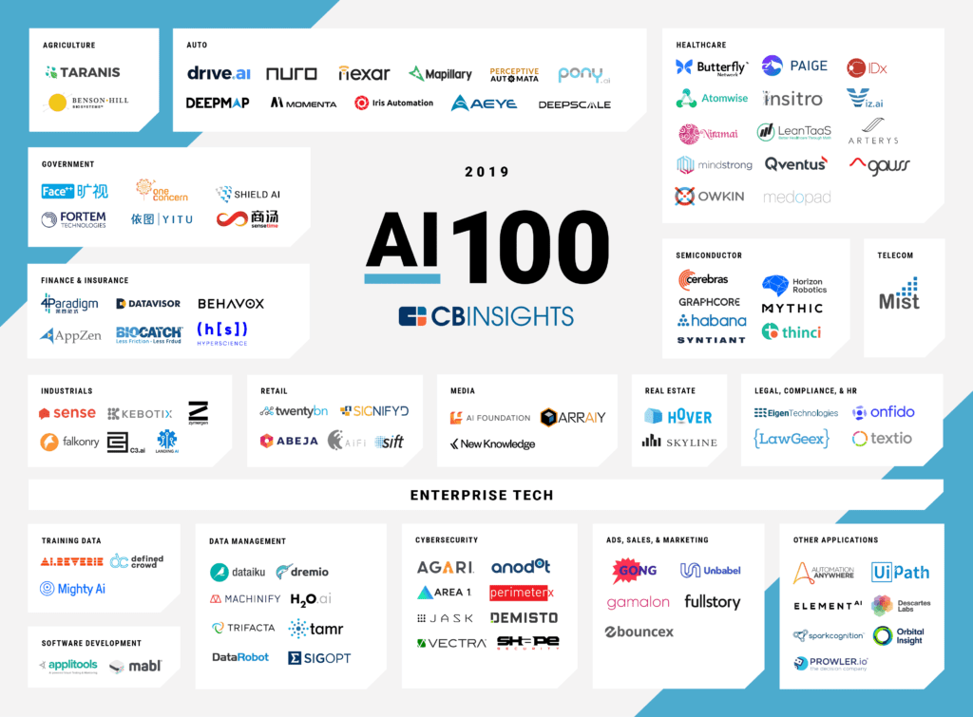
AI startups-2019
Anthropic PBC- LLM

Slide 22
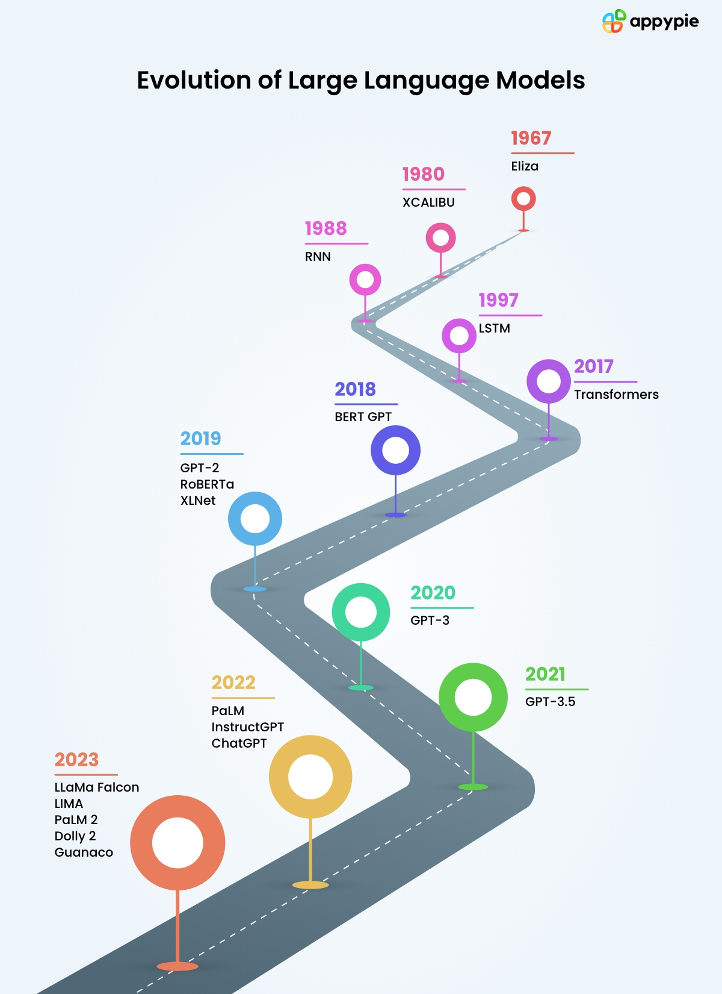
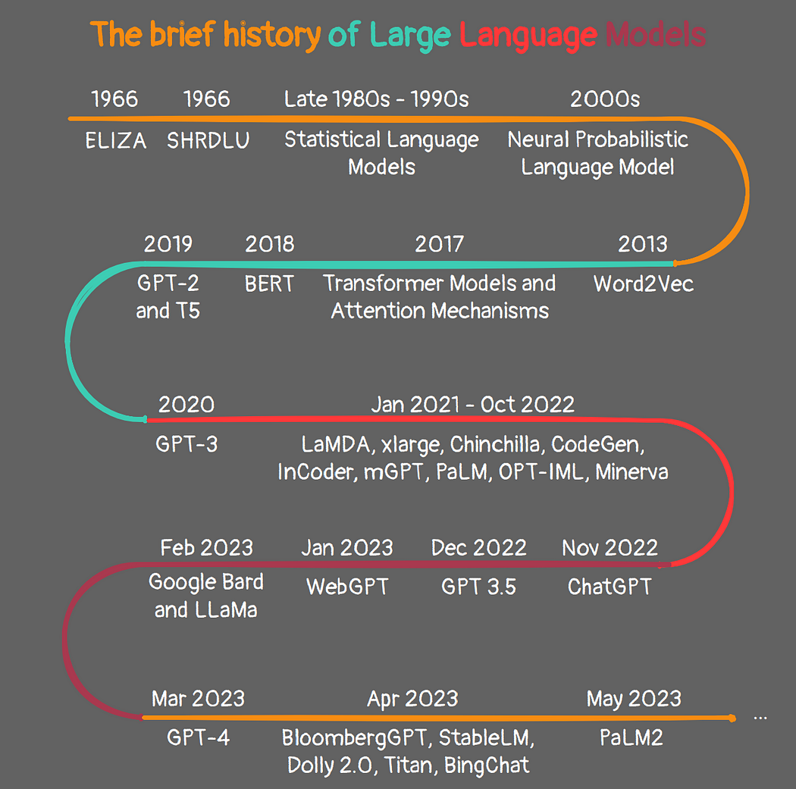

Slide 23
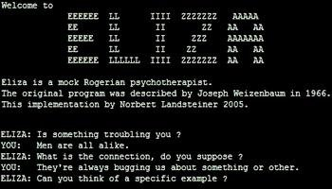
Rule-Based Language Models (1950s - 1960s)
History of language models starts in the 1950s with rule-based systems
Early attempts constrained by manual design of grammatical rules
Joseph Weizenbaum's "ELIZA" program introduced in 1966
ELIZA operated as a simulated Rogerian psychotherapist
Pioneering example of dialogue simulation
Interactions primarily based on pre-defined patterns
Lacked genuine comprehension of language nuances
Efforts to development of more sophisticated rule-based systems.
Yet, these systems remained constrained by the intricacies of human language, struggling to grasp contextual subtleties and adapt to diverse linguistic expressions.
Researchers increasingly recognized the need to learn and generalize from data.
This led to the emergence of statistical language processing techniques, such as n-grams and Hidden Markov Models,

Slide 24
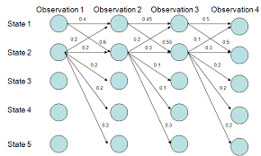
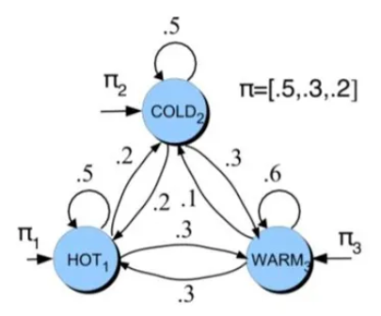
2. Statistical Language Processing (1990s - early 2000s)
Shift towards statistical approaches in language processing during the 1990s
Embrace of vast text datasets to uncover patterns and interconnections
Prominent techniques: Hidden Markov Models (HMMs) and Conditional Random Fields (CRFs)
Revolutionized tasks like part-of-speech tagging and named entity recognition
HMMs and CRFs enabled systems to identify grammatical roles and extract specific information from text
Departure from rigid rule-based systems to more adaptable and context-sensitive processing
Despite successes, models still grappled with complexities of language
Setting the stage for next era of advancements in language models

Slide 25
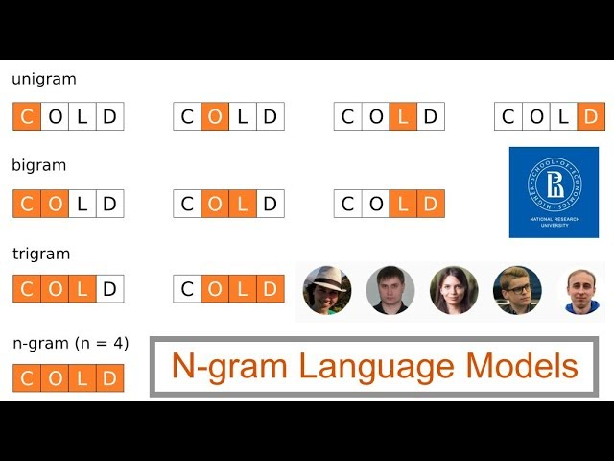
3. N-gram Models (1990s - early 2000s)
Emergence of N-gram models in 1990s and early 2000s
Concept: Probability of a word's appearance based on preceding words
Simple yet powerful mechanism for statistical language modeling
Focus on local relationships between words to capture context
Introduction of essential mechanism for understanding language
Notable application: Google's PageRank algorithm (1996) PageRank's revolutionary approach to web search
Utilization of N-gram analysis to assess word co-occurrences
Effective ranking of web page relevance
Showcase of N-gram model's potential beyond language processing
Highlighting significance of contextual information in language
Paving the way for development of more intricate techniques in linguistics

Slide 26
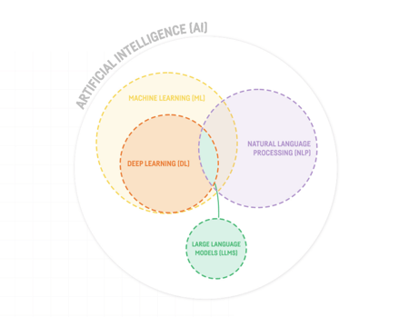
4. Neural Networks and the Rise of LLMs (The late 2000s - onward)
Late 2000s: Resurgence of interest in neural networks, especially deep learning techniques
Adoption of Recurrent Neural Networks (RNNs) and Long Short-Term Memory (LSTM) networks for processing sequential data
Breakthrough application: Machine translation : Google's "Neural Machine Translation" system (introduced in 2016) outperformed conventional methods
Introduction of Word2Vec model in 2013 by Tomas Mikolov and team at Google
Word2Vec model learned distributed representations of words from contextual usage in large text datasets
Foundation for capturing semantic relationships between words established
Enhancement of language understanding beyond statistical associations

Slide 27

5. Sequence-to-Sequence Models (2014 - onward)
Sequence-to-sequence models: Architecture of Recurrent Neural Networks, Utilization of encoder-decoder architectures with attention mechanisms
Handling various language tasks such as machine translation and text summarization
Introduction of Google's "Transformer" architecture in 2017 :Presented in the paper "Attention is All You Need"
Revolutionized sequence modeling by enabling parallel processing of sequences,Effective capture of long-range dependencies
Integration of self-attention mechanisms to seamlessly incorporate contextual information from all positions within a sequence
Architectural leap enhances performance in tasks requiring nuanced context comprehension

Slide 28
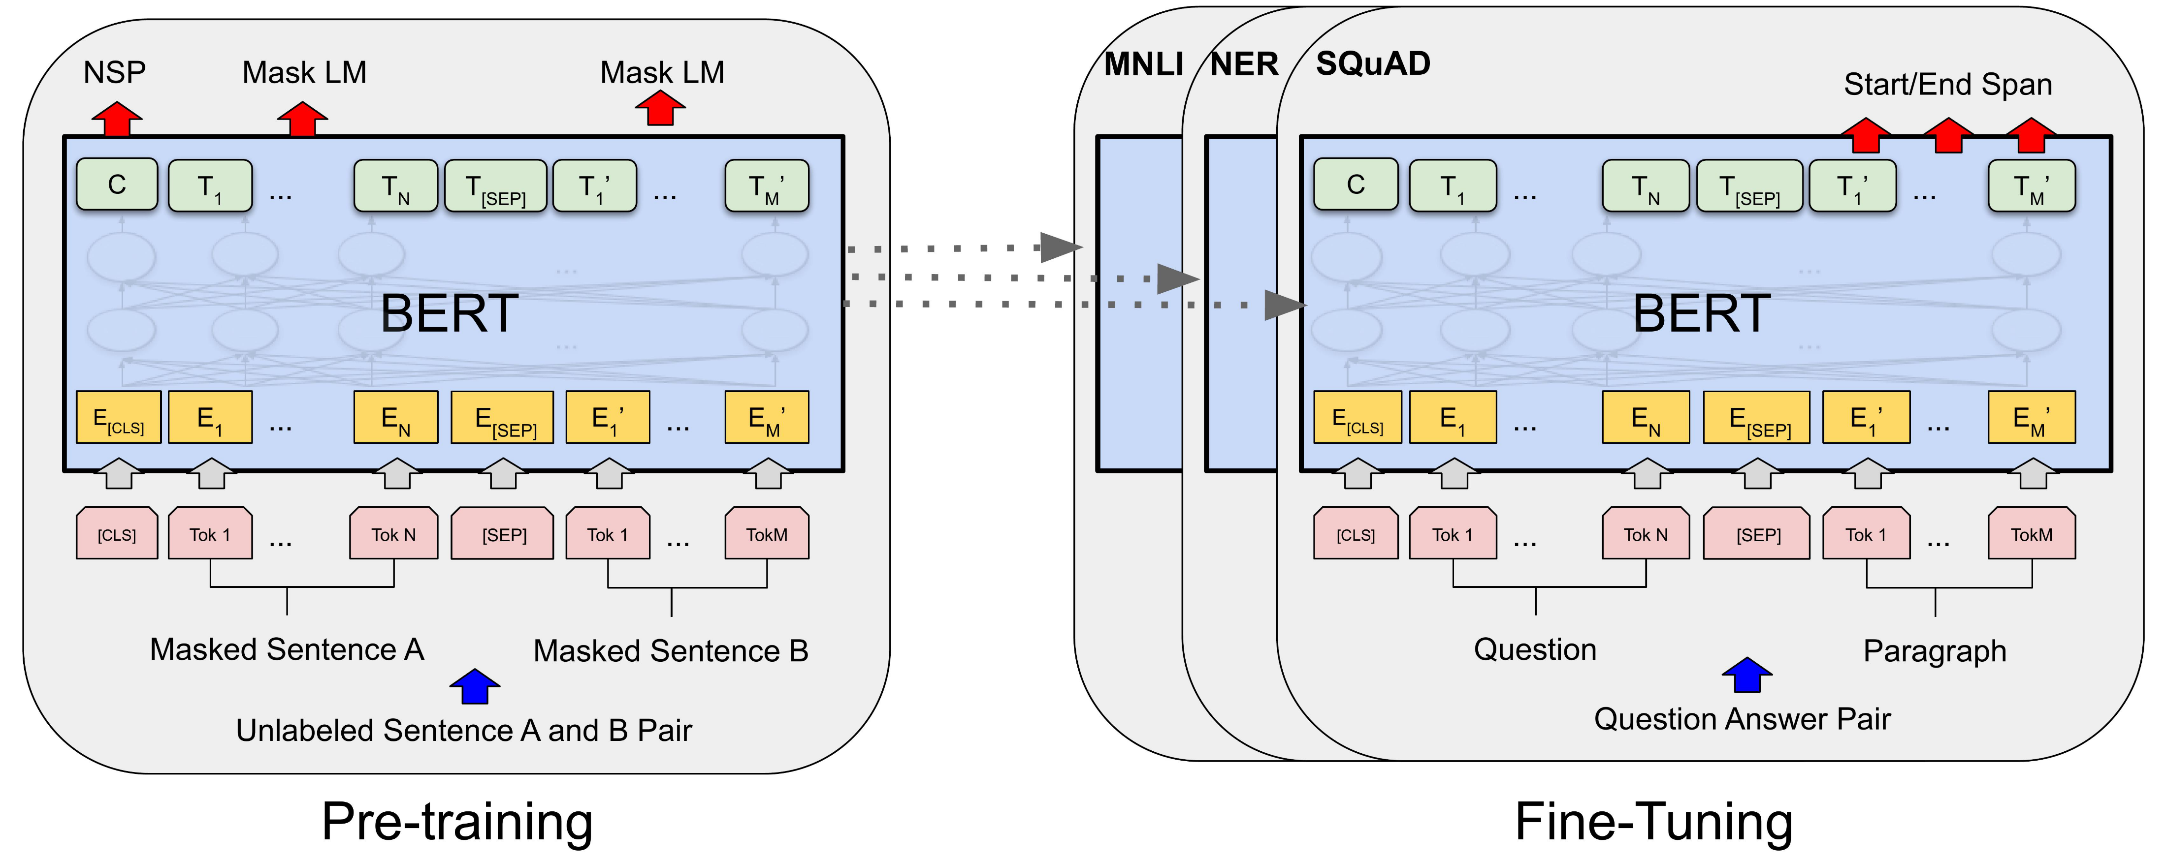
6. BERT and Pre-trained Models (2018 - onward)
Introduction of Bidirectional Encoder Representations from Transformers (BERT) in 2018 Developed by Google,
Pre-training of a massive transformer model on extensive textual data
Fine-tuning of pre-trained BERT model for specific tasks
Applications include question answering and sentiment analysis
Paradigm shift from rigid, task-specific models to adaptable and transferable representations
Harnessing vast amounts of text data during pre-training for comprehensive understanding of language nuances and contextual relationships

Slide 29

7. GPT Series (2019-onward): Scaling Up and Generative Power: LLM
Launch of OpenAI's "Generative Pre-trained Transformer" (GPT) series, starting with GPT-2 in 2019 Watershed moment in the realm of large language models
GPT-2 raised concerns about misuse but shattered boundaries of text generation, Exhibited extraordinary aptitude for crafting coherent and contextually rich text
Capabilities included generating creative prose, answering queries, and producing news articles
Spotlighted immense potential and challenges of large-scale generative models
Proficiency in comprehending and producing human-like text showcased profound advances in deep learning and natural language processing
Cautious unveiling of GPT-2 due to potential for generating deceptive content
Underscored the need for ethical considerations and responsible deployment of such models
Pivotal juncture prompting reevaluation of impact on communication, creativity, and information dissemination

Slide 30
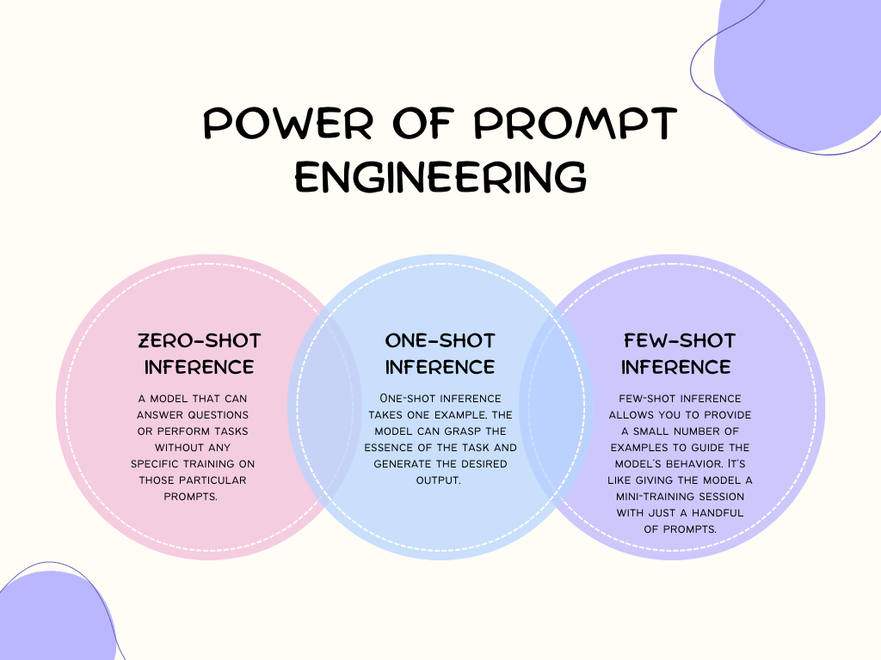
8.GPT-3: The Megamodel (2020 - onward)
Release of GPT-3 by OpenAI in 2020, one of the largest language models with 175 billion parameters
Highlighted substantial real-world applications of Large Language Models (LLMs)
Broad spectrum of capabilities including language translation, text completion, coding assistance, and interactive storytelling
Remarkable "few-shot" and "zero-shot" learning abilities, enabling performance with minimal training examples or none at all
Potential of "prompt engineering" to guide GPT-3's responses, allowing users to influence and tailor its output
Reshaped perception of what LLMs can achieve, reshaping interactions and possibilities across numerous domains
Contrasting LLMs with Traditional Language Models:
LLMs leverage massive amounts of data and parameters for more nuanced and contextually rich language processing
Traditional language models often rely on handcrafted rules or statistical techniques and may struggle with capturing complex linguistic nuances
LLMs excel in tasks requiring natural language understanding and generation, offering greater flexibility and adaptability in various applications

Slide 31

9. GPT-4 (2023): Multimodal Large Language Model
GPT-4 represents a revolutionary cornerstone in the realm of Large Language Models (LLMs)
Pushes the envelope of language comprehension and generation to new heights
Evolutionary leap from its predecessors, GPT-4 serves as an AI-powered chatbot
Takes the art of text manipulation to new heights with augmented parameter counts and refined architectures
Represents a paradigm shift that amplifies the capabilities of LLMs
Paves the way for transformative applications in various domains
Excels in understanding intricate nuances and generating contextually coherent text
Proficiency spans an array of tasks including creative composition and problem-solving
Exemplifies the potent synergy of artificial intelligence and human-like language manipulation

Slide 32


GPT-4 : Multimodal capabilities
GPT-4, the latest milestone in OpenAI’s effort in scaling up deep learning. GPT-4 is a large multimodal model (accepting image and text inputs, emitting text outputs) that, while less capable than humans in many real-world scenarios, exhibits human-level performance on various professional and academic benchmarks.

Slide 33
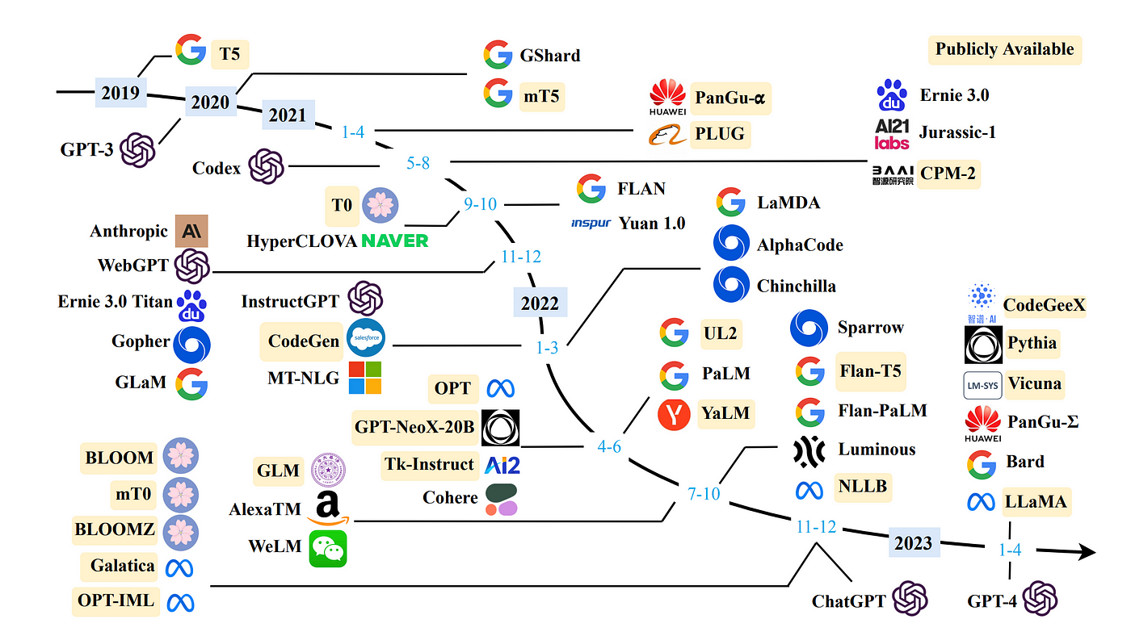

Slide 34
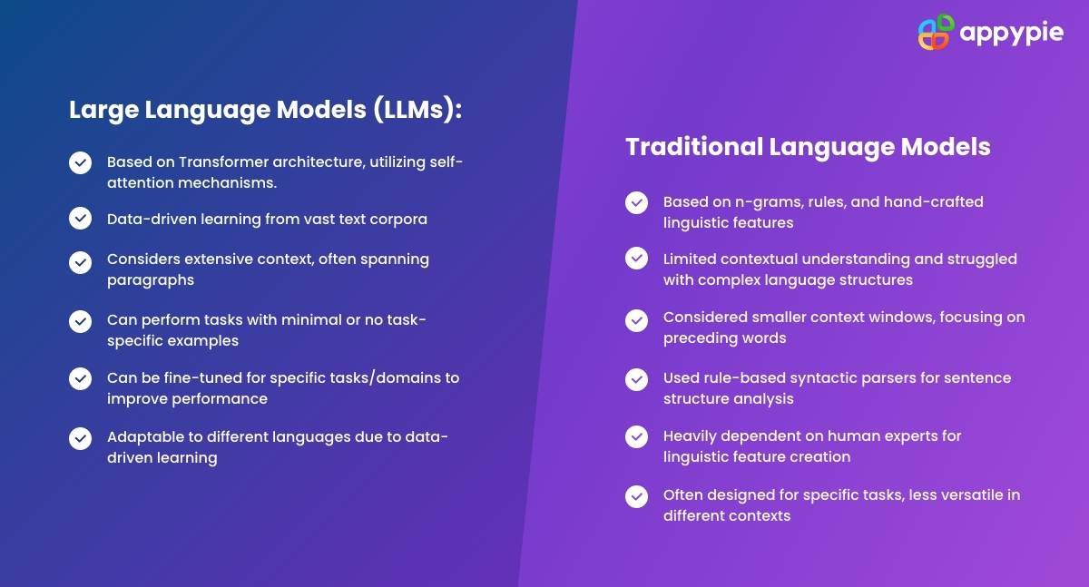

Slide 35
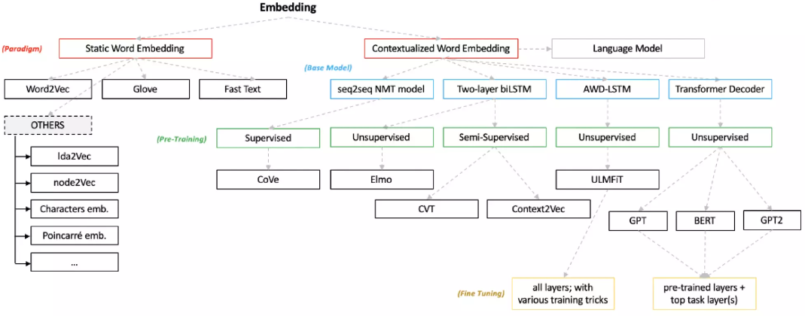
Word Embeddings

Slide 36
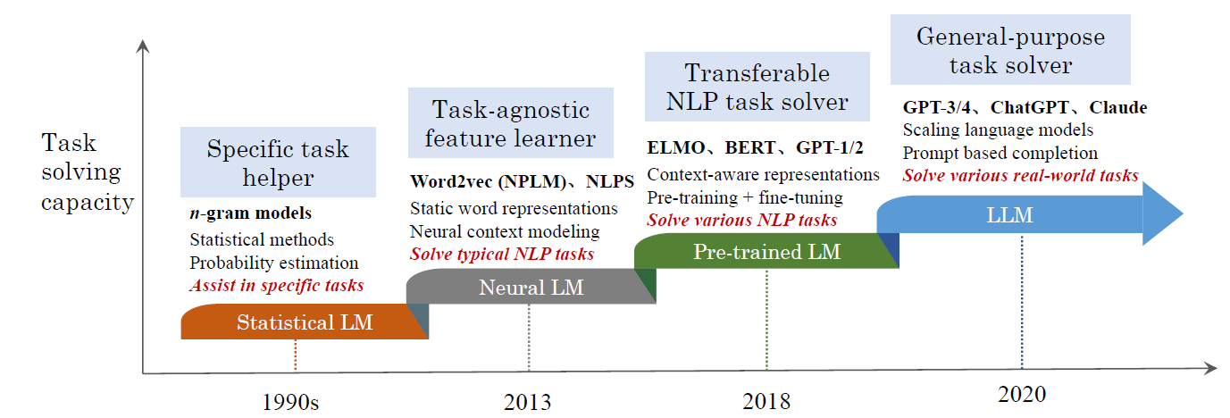
Pre-training, adaptation tuning, utilization, and capacity evaluation
Recent advances in LLMs
from four major aspects, including pre-training (how to pretrain
a capable LLM), adaptation (how to effectively adapt
pre-trained LLMs for better use), utilization (how to use
LLMs for solving various downstream tasks) and capability
evaluation (how to evaluate the abilities of LLMs and existing
empirical findings)

Slide 37
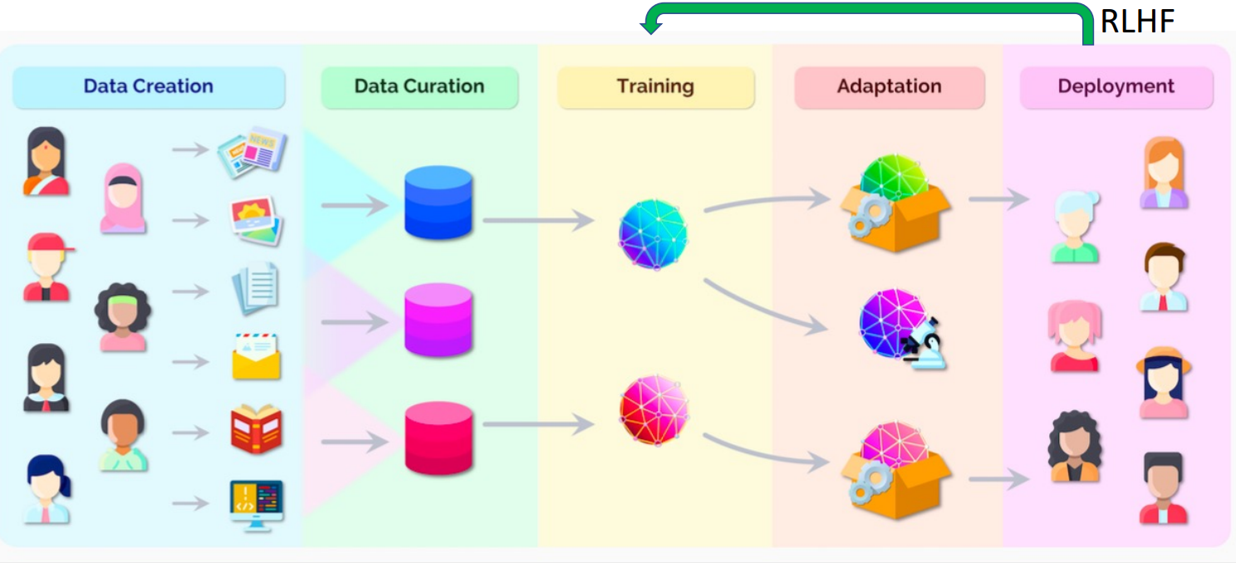
LLM Models
when the parameter scale exceeds a certain level, these enlarged language models not only achieve a significant performance improvement, but also exhibit some special abilities (e.g., in-context learning) that are not present in small-scale language models (e.g., BERT). To discriminate the language models in different parameter scales, the research community has coined the term large language models (LLM) for the PLMs of significant size (e.g., containing tens or hundreds of billions of parameters).

Slide 38
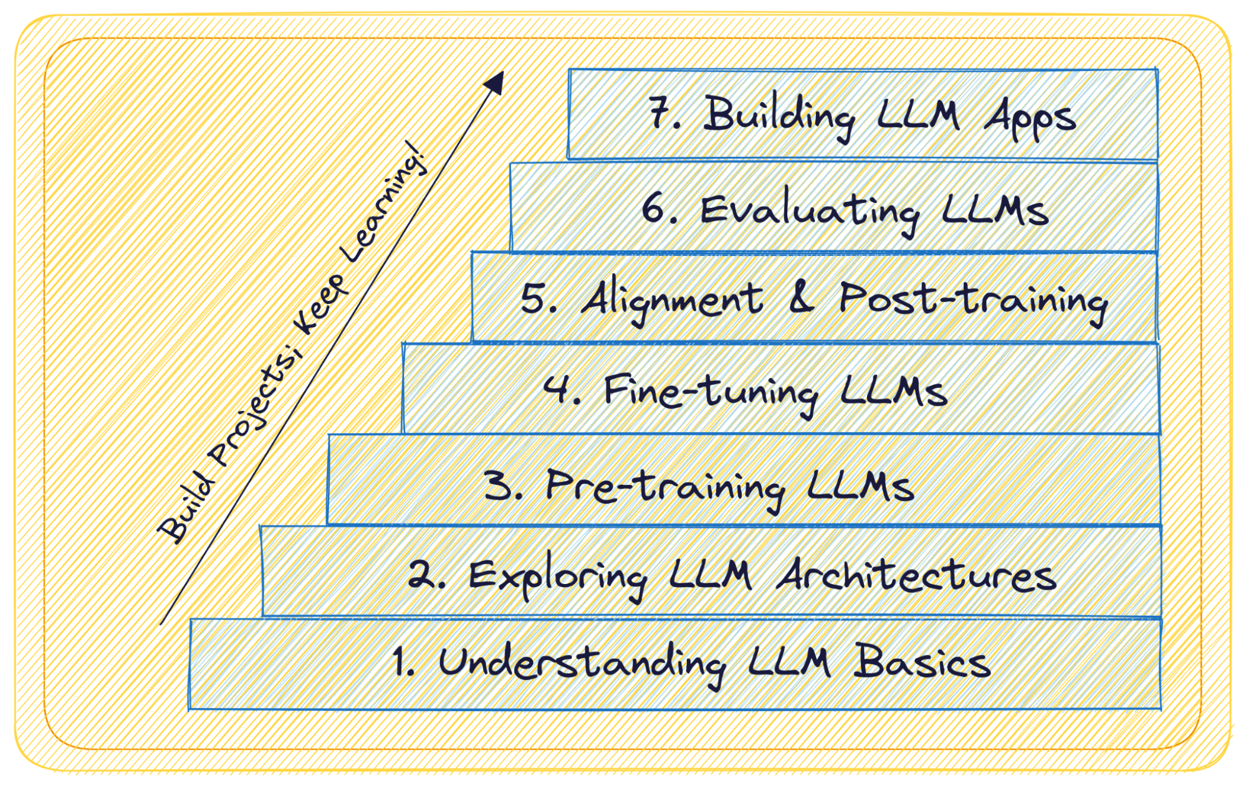
LLMs
web-based interfaces, mobile apps, chatbots,
Deployment : Cloud , Containerisation
Task Metrics, Human Evaluation, Bias and Fairness , Robustness and Adversarial Testing,
Reinforcement Learning from Human feedback (RLHF) , Contrastive Post-training
In-context Learning- hard and soft prompts
PEFT – adapters- LoRA, QLoRA , Quantization
Transformer Architectures : Encoder only, Decoder Only, Encoder-Decoder
Transformers : Attention is all you Need
What are LLMs?
Large Language Models—or LLMs—are a subset of deep learning models trained on massive corpus of text data. They’re large—with tens of billions of parameters—and perform extremely well on a wide range of natural language tasks.
LLMs have the ability to understand and generate text that is coherent, contextually relevant, and grammatically accurate

Slide 39
LLM Challenges
Data Biases: Language models trained on large datasets can inherit biases present in the data, including gender, racial, and cultural biases. This can lead to biased outputs, reinforcing societal stereotypes.
Ethical Use: There are concerns about the potential misuse of large language models for generating fake content, spreading misinformation, or even automating tasks such as generating spam, fake reviews, or abusive messages.
Environmental Impact: Training large language models requires significant computational resources, which can have a considerable carbon footprint. This raises environmental concerns, especially as the size and number of models continue to grow.
Resource Inequality: Access to and control over large language models are concentrated in the hands of a few large organizations due to the high cost of development and maintenance. This can exacerbate existing inequalities and limit access to the benefits of these models.
Privacy Risks: Large language models have the potential to memorize sensitive information present in the training data, posing privacy risks, especially when fine-tuned on specific datasets containing personal or confidential information.
Lack of Understanding: Despite their impressive performance, there's still limited understanding of why large language models make specific predictions or generate particular outputs. This lack of interpretability can be problematic, especially in critical applications like healthcare or law.
Adversarial Attacks: Large language models are vulnerable to adversarial attacks, where intentionally crafted inputs can cause the model to produce incorrect or undesirable outputs. This raises concerns about the robustness and reliability of these models in real-world scenarios.
Safety and Control: There are concerns about the potential for large language models to generate harmful or malicious content, such as hate speech, propaganda, or incitements to violence. Ensuring safety and control over model outputs is a significant challenge.
Regulatory and Legal Issues: The rapid development and deployment of large language models raise regulatory and legal challenges, particularly regarding intellectual property rights, liability for generated content, and compliance with existing regulations.
Continual Training and Updates: Large language models require continual training and updates to maintain their performance and relevance over time. This necessitates significant resources and infrastructure, posing logistical challenges for organizations deploying these models.

Slide 40

LLM Challenges
Data Biases
Ethical Use:
Environmental Impact:.
Resource Inequality:
Privacy Risks:.
Lack of Understanding:
Hallucination
Adversarial Attacks:
quality, integrity, and completeness of training data
Safety and Control: Regulatory and Legal Issues:
Continual Training and Updates

Slide 41
Hallucination
The unstructured nature of input being fed into ChatGPT tools brings inherent risks of generating irrelevant and off-topic content. A poorly-trained LLM is prone to producing false, functional knowledge not supported by any training data — as an extrapolation from your prompt.
The reasons for this lapse of judgment are many — from overfitting to poor prompts to complete datasets. That’s why, the quality, integrity, and completeness of training data are vital to set the model straight.
Biases
Similar to other natural language processing applications, LLMs can inadvertently amplify biases present in the training data. This happens when the data doesn’t represent the entire population, causing your model to produce unreliable results. This, again, puts a special emphasis on accurate curation of training data and ensuring its completeness and versatility.
Data privacy concerns
A large number of open-source LLMs store and process data on the provider’s servers, which goes against enterprise data protection regulations. To introduce a language model into your corporate environment, you have to deploy the model locally via APIs. This way, your sensitive data will be kept under lock and key.

Slide 42
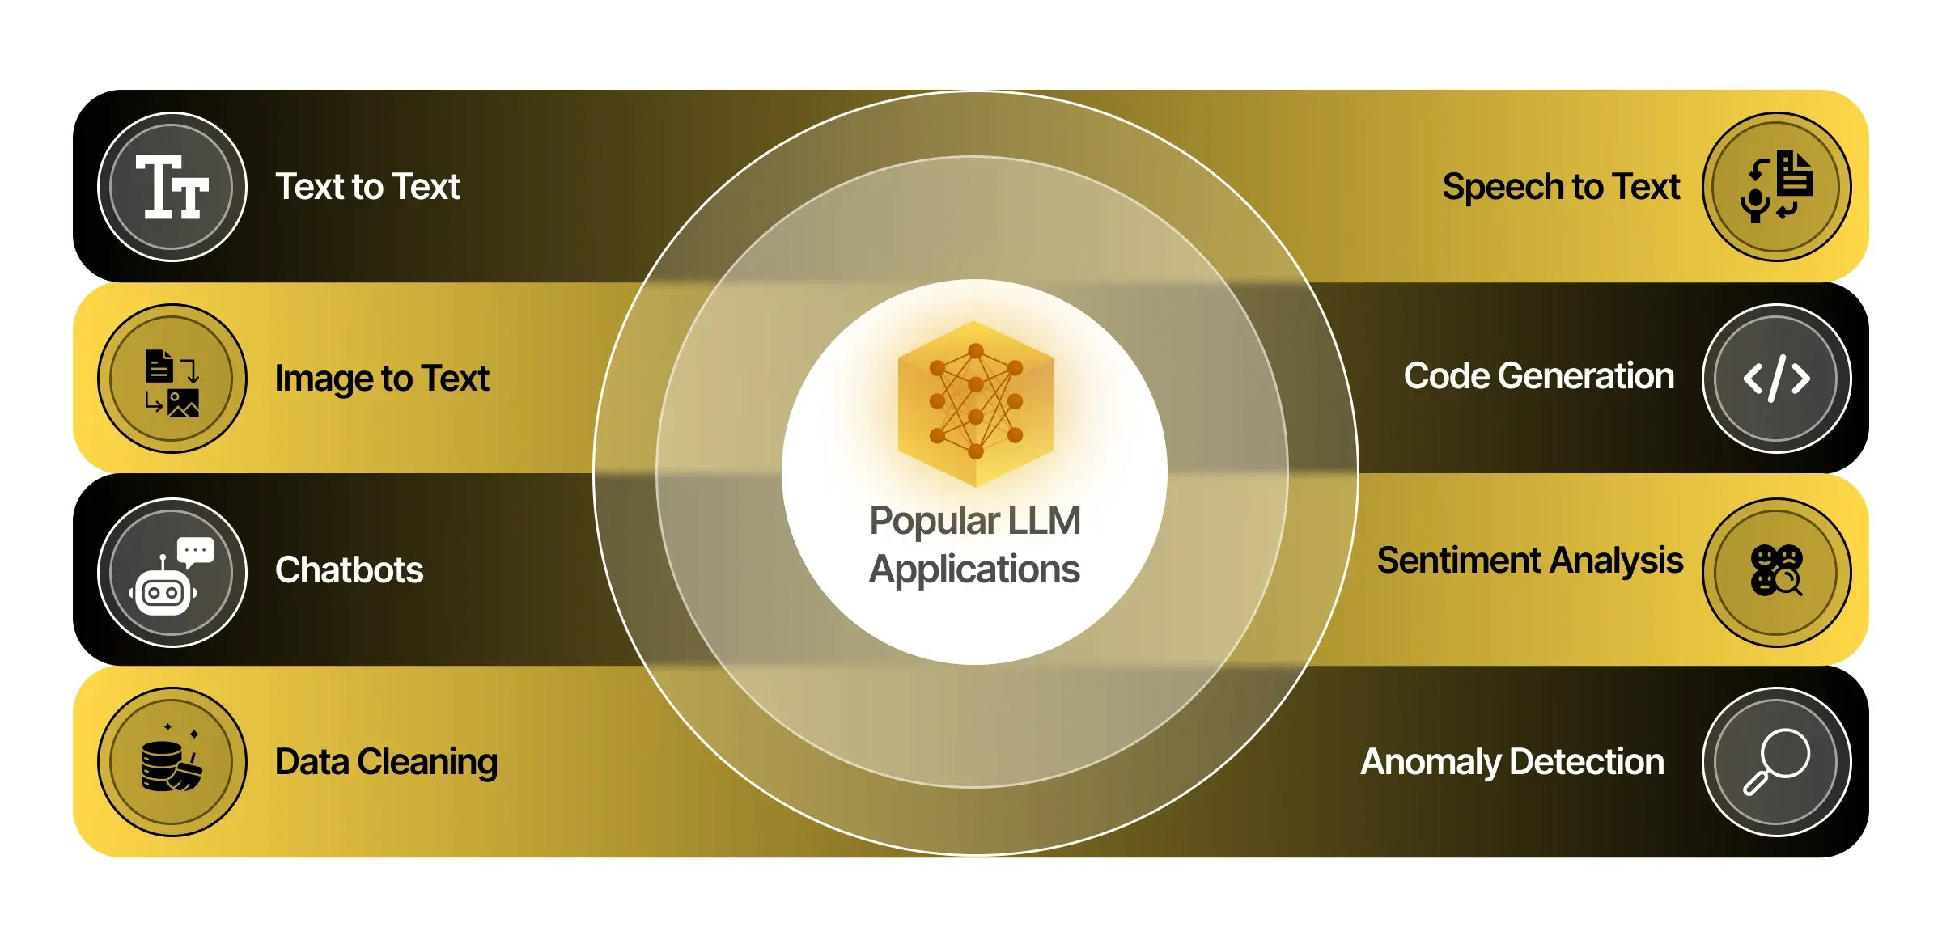

Slide 43
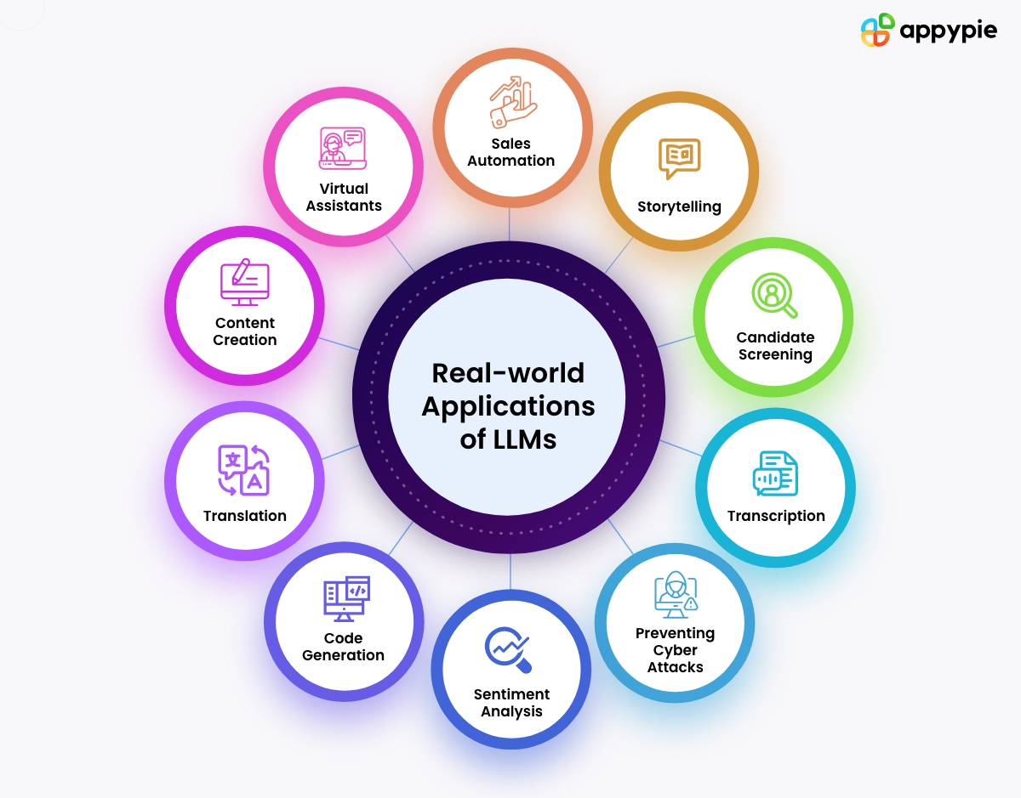

Slide 44
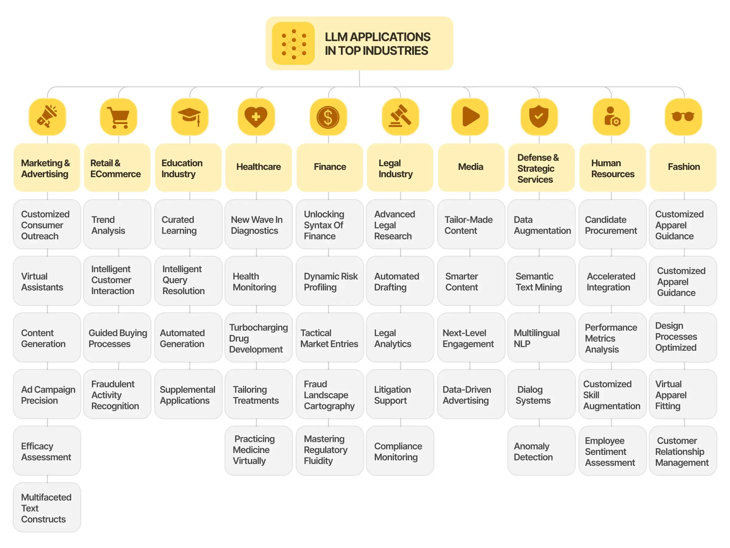

Slide 45
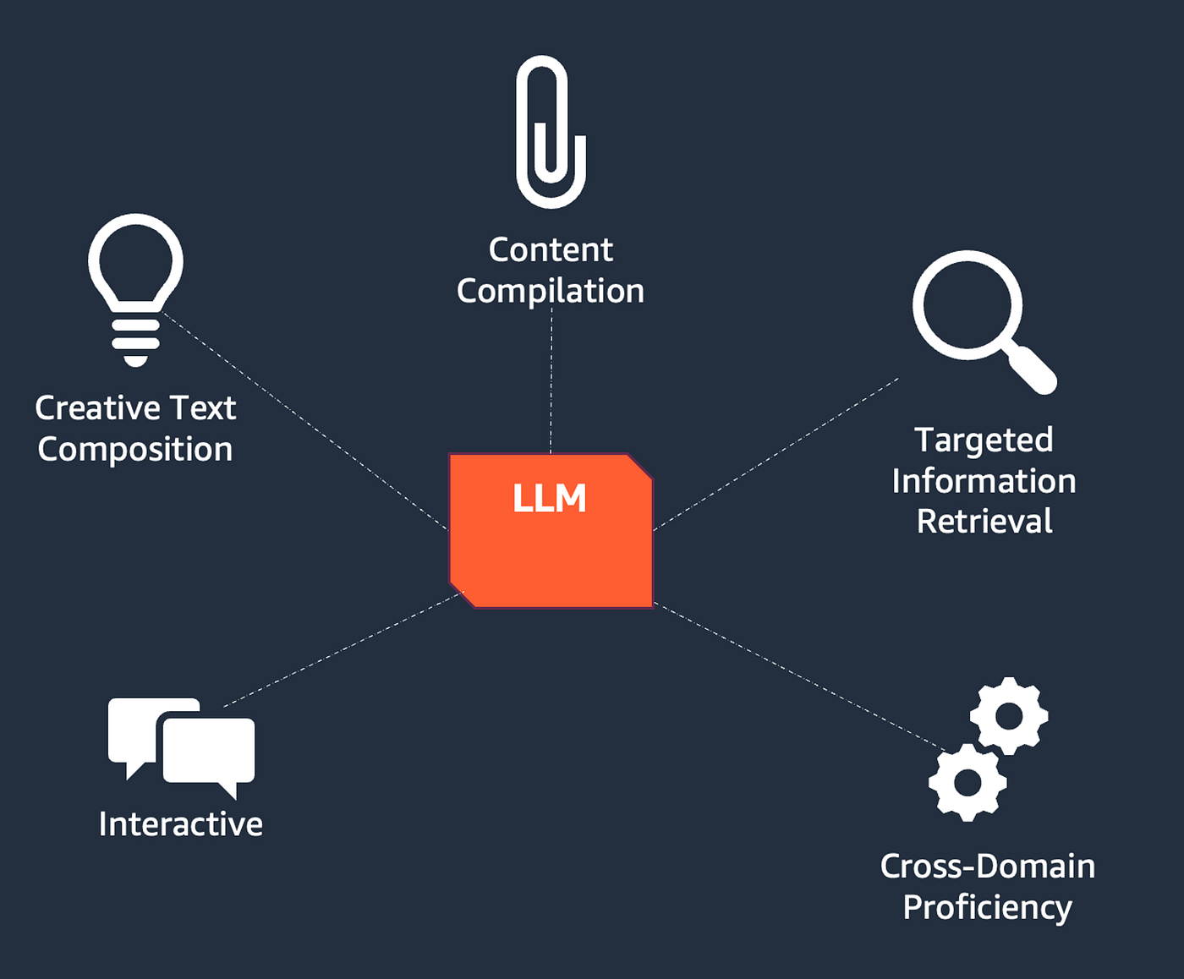
Generative AI in Content Creation

Slide 46
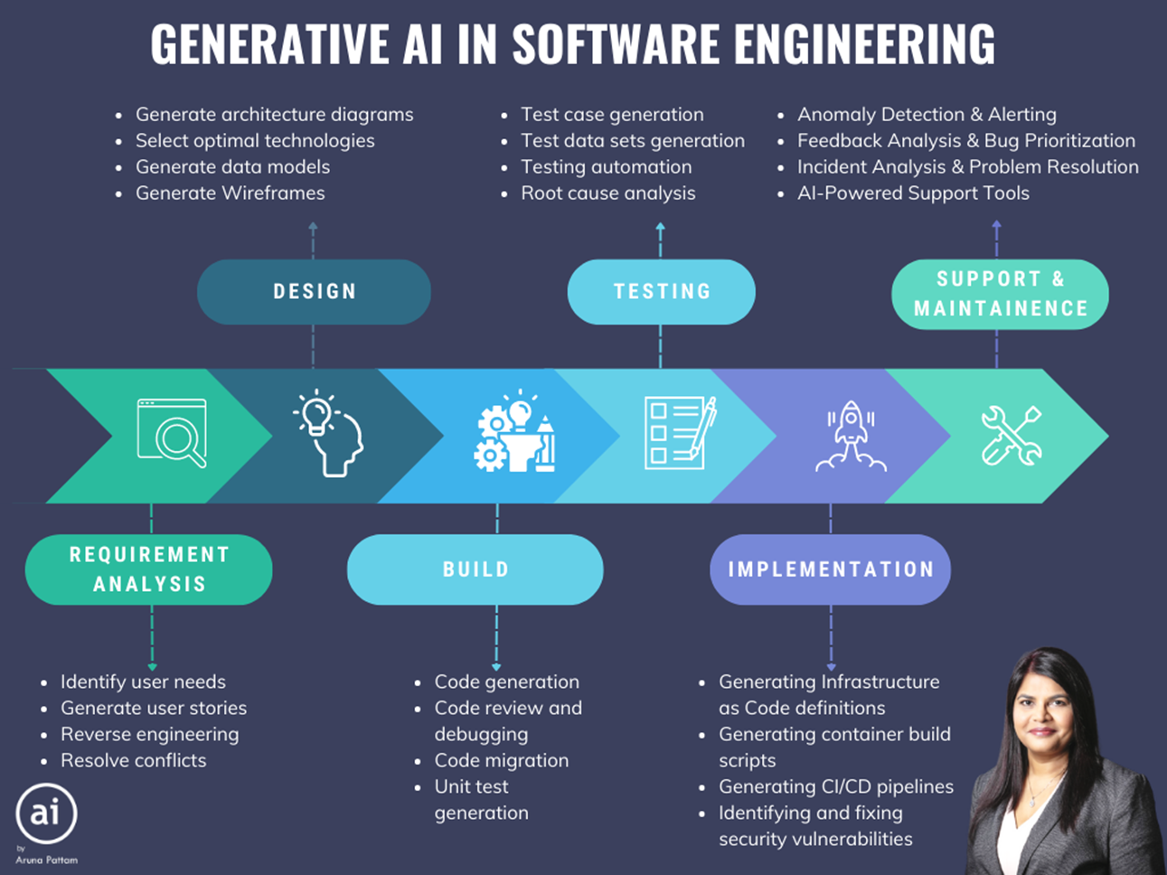

Slide 47
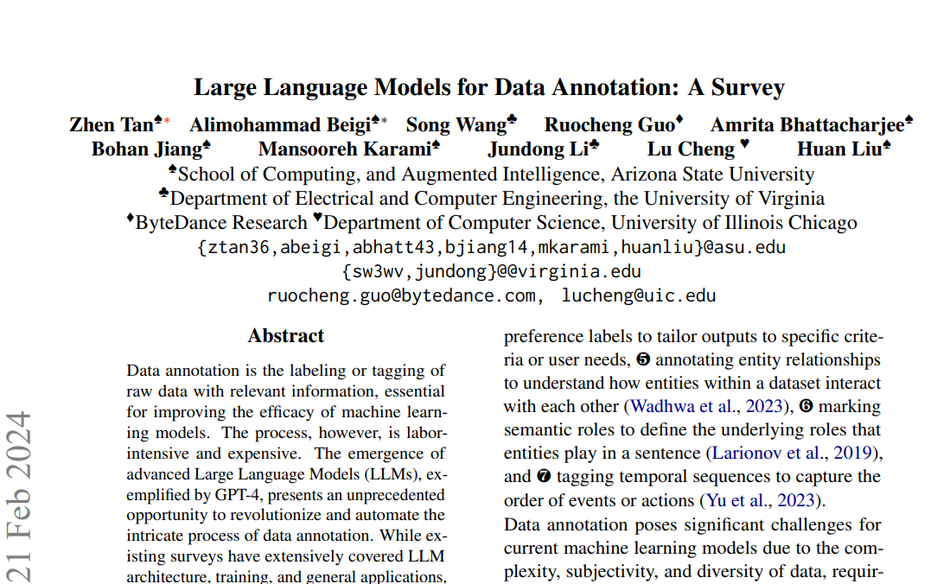
LLM for Data Annotation

Slide 48
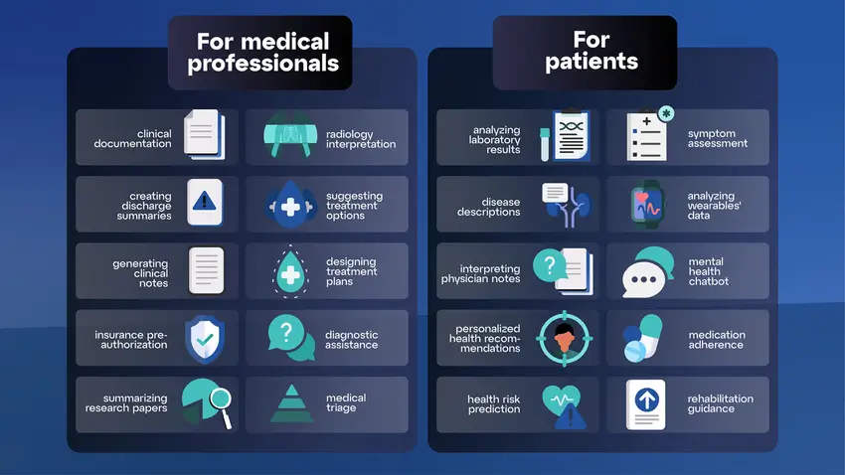
LLM Use-Cases in Healthcare
Personalized Medicine: An LLM analyzes a patient's genetic data and medical history to suggest targeted treatment options and predict potential health risks. This personalized approach leads to more effective and preventative care.
Mental Health Chatbot: An LLM-powered chatbot provides 24/7 emotional support, offers cognitive-behavioral therapy techniques, and flags potential mental health concerns for further professional intervention. This increases access to mental health resources and early intervention.
LLMs have been particularly effective is in the analysis of Electronic Health Records (EHRs). By analyzing EHRs with LLMs, healthcare professionals can identify patterns and insights that would have otherwise gone unnoticed.

Slide 49
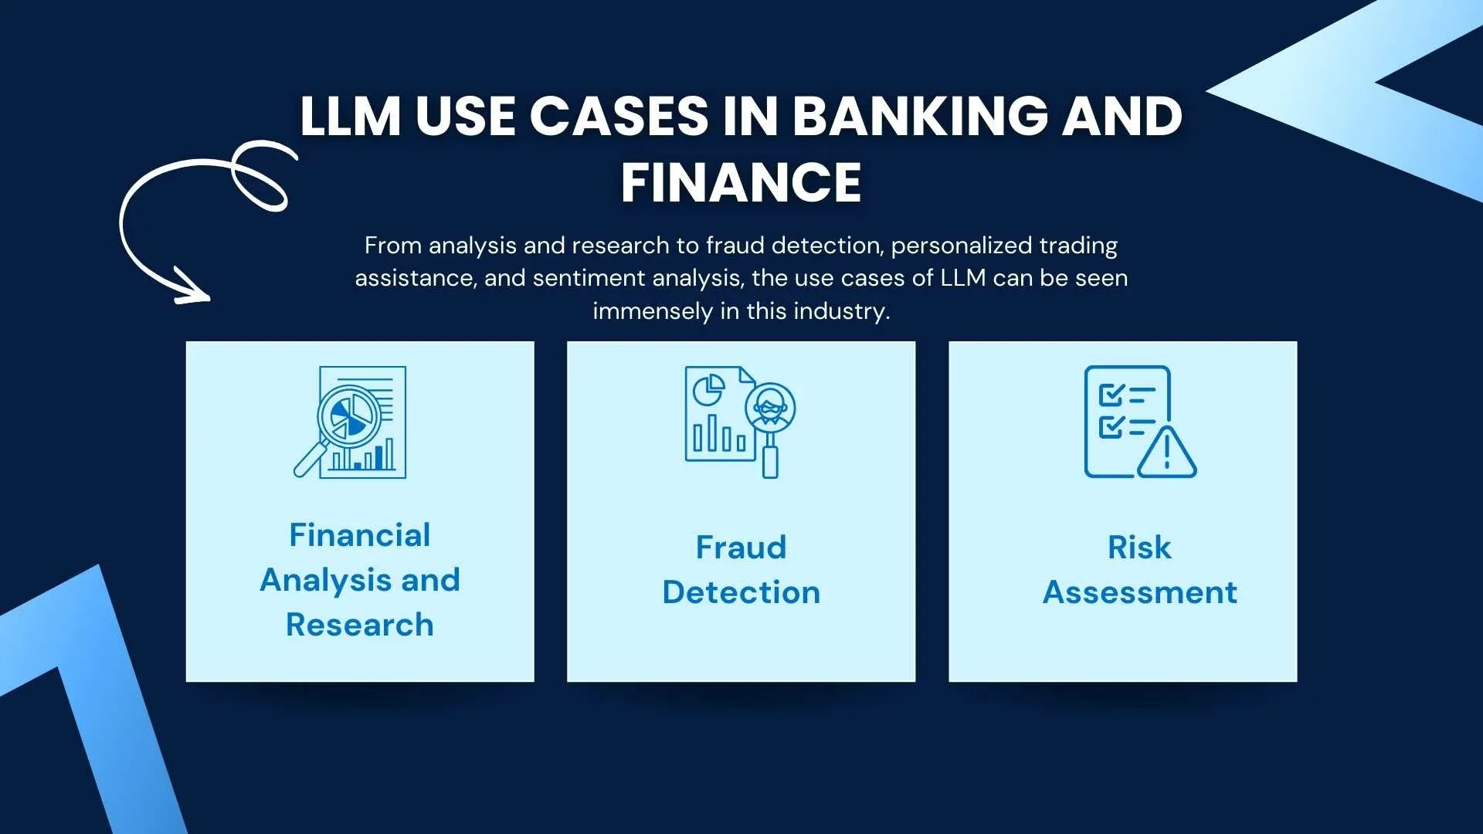
LLM Use-Cases in Finance
LLM technology can analyze vast amounts of data with lightning speed, making it easier to identify patterns of fraudulent behavior. By using LLMs, financial institutions can prevent fraudulent activities before they even occur.
LLMs are also being used to predict stock prices.
Algorithmic Trading: An LLM analyzes historical market data, news sentiment, and social media trends to identify and exploit fleeting trading opportunities. This high-frequency trading approach requires strict regulation and risk management.
Fraud Detection: An LLM monitors financial transactions in real-time, identifying suspicious patterns and anomalies that could indicate fraudulent activity. This proactive approach helps prevent financial losses for both institutions and individuals.

Slide 50
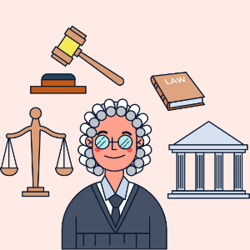
LLM Use-Cases in the Legal Industry
Contract Review Assistant: An LLM scans legal contracts, highlighting key clauses, identifying potential risks, and suggesting alternative language for clarity and fairness. This saves lawyers time and ensures accurate contract interpretation.
Legal Research Assistant: An LLM quickly searches through vast legal databases, identifying relevant case law, precedents, and legal scholarship based on specific legal questions. This streamlines legal research and improves the efficiency of legal teams.

Slide 51
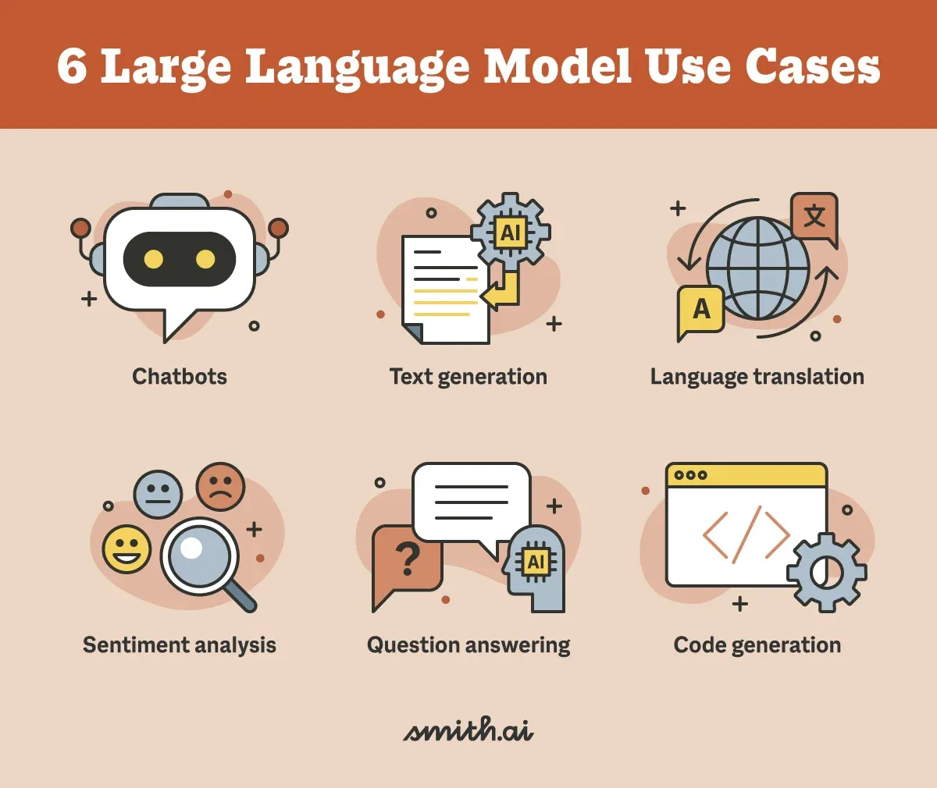
LLM Use-Cases in Education
Adaptive Learning Platform: An LLM tailors educational materials and assessments to individual student needs and learning styles, providing personalized feedback and adjusting difficulty levels in real-time. This personalized approach improves learning outcomes and caters to diverse learning styles.
Automated Grading and Feedback: An LLM grades essays and written assignments, providing detailed feedback on grammar, style, and content. This frees up teachers' time and helps students understand their strengths and weaknesses.

Slide 52
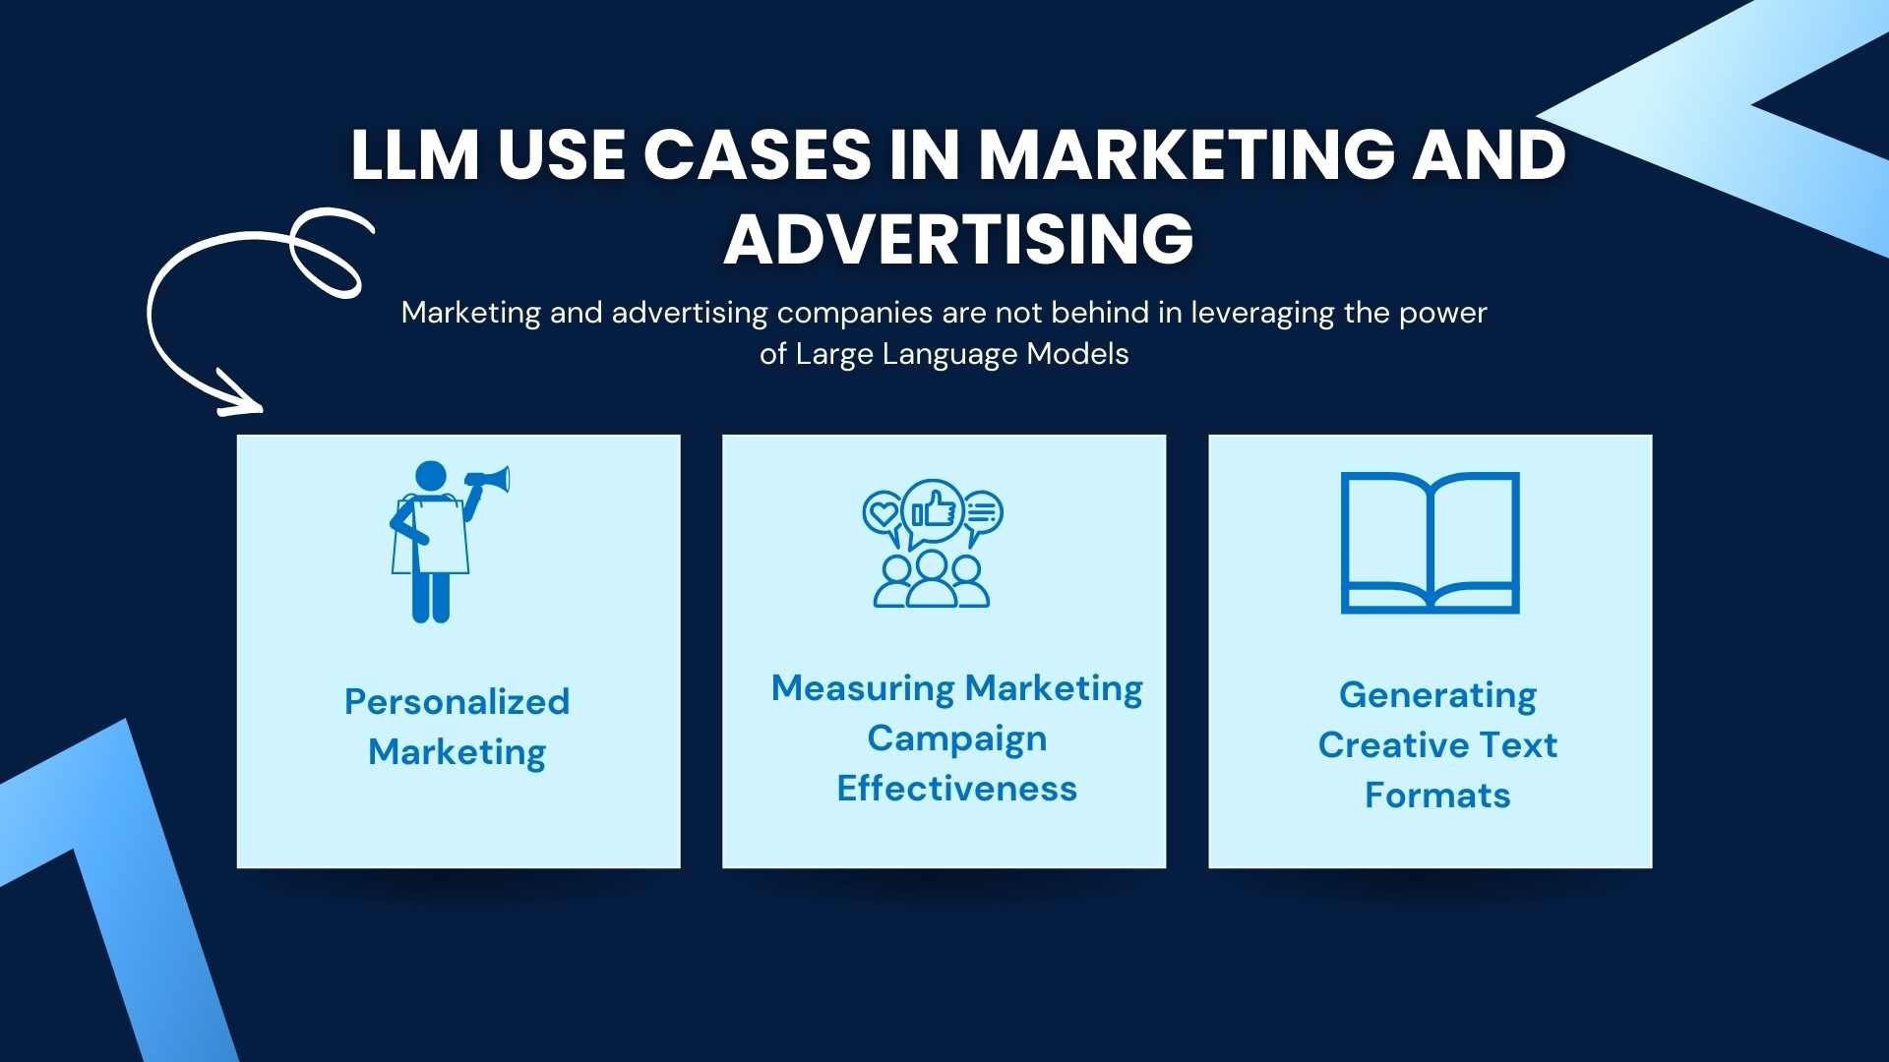
LLM Use-Cases in Marketing and Advertising
Dynamic Content Generation: An LLM generates personalized marketing copy, website content, and social media posts based on user data and preferences. This targeted approach increases engagement and conversion rates.
Micro-Influencer Identification: An LLM analyzes social media data to identify nano- and micro-influencers relevant to specific brands and campaigns, facilitating targeted influencer marketing strategies. This leverages the power of smaller, more authentic social media personalities.

Slide 53
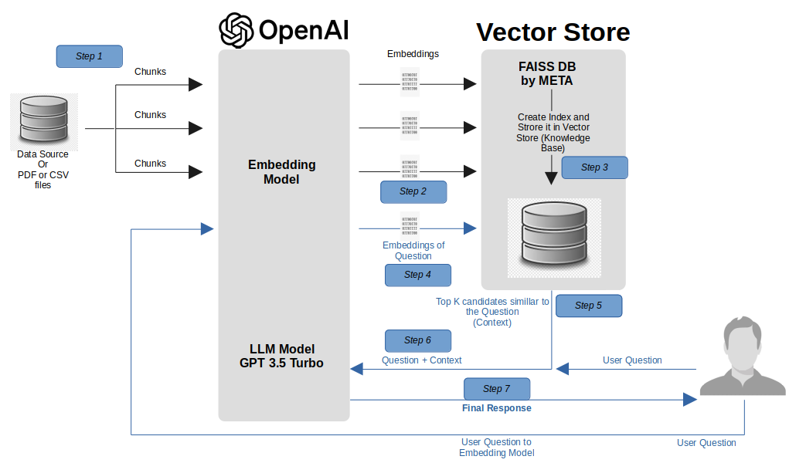
LLM Use-Cases in Customer Service
Emotionally Intelligent Chatbot: An LLM understands and responds to customer emotions in real-time, providing empathetic support and resolving inquiries effectively. This improves customer satisfaction and reduces the burden on human customer service representatives.
Predictive Maintenance: An LLM analyzes device data to predict potential failures before they occur, enabling proactive customer service interventions and preventing downtime. This improves customer experience and reduces repair costs.

Slide 54
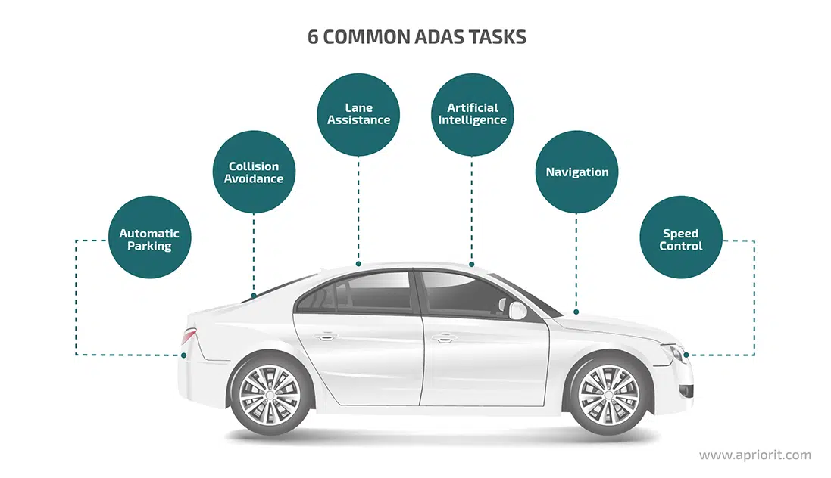
LLM Use-Cases in Automotive
Traffic Prediction and Route Optimization: An LLM analyzes historical traffic data and real-time sensor information to predict traffic patterns and suggest optimal routes for drivers. This reduces congestion, optimizes fuel efficiency, and improves overall driving experience.
Personalized Car Maintenance: An LLM analyzes vehicle data, including driving patterns, sensor readings, and maintenance history, to predict potential maintenance needs and personalize service recommendations. This proactive approach prevents breakdowns and reduces repair costs for car owners.
Future vehicles might communicate with passengers, pedestrians, and even other vehicles using advanced AI language models.

Slide 55

LLM Use-Cases in Government
Public Policy Analysis and Simulation: An LLM analyzes vast amounts of public data, including citizen feedback, economic indicators, and social trends, to simulate the potential impacts of proposed policies. This helps policymakers make informed decisions and mitigate potential negative consequences.
Disaster Response and Resource Allocation: An LLM analyzes real-time data from disaster zones, including weather patterns, infrastructure damage, and population displacement, to inform efficient resource allocation and optimize emergency response efforts. This saves lives and minimizes the impact of natural disasters.

Slide 56

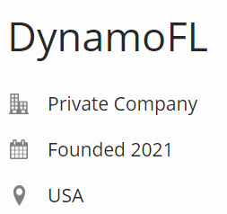

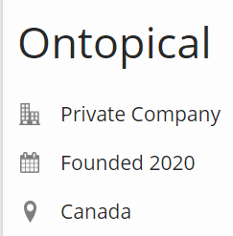

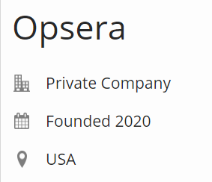











Top LLM startups ( 2019-2023)
Lot more…..

Slide 57
Opportunities are plenty!
Sky is the Limit

Slide 58
Namah Shivaya

